Slide 1
Python Based Voice Controlled Personal Assistant
Venkat Sai Swarup Bennabhaktula (2017IMT-109)
Vishwajeet Kumar (2017IMT-111)
Aryan Bharadwaj (2017IMT-018)
Submitted to :
Dr. Somesh Kumar
Associate Professor
ABV-IIITM Gwalior
474010, MP, India
June 8 ,2020

Slide 2
Problem Statement :
The problem at hand is to build a python based voice digital assistant that helps you to automate your daily tasks in day to day life by taking voice and text as inputs respectively.

Slide 3
Why do we need such a system ?
With the increasing technology the need of digital voice assistant has increased which help automate our daily tasks making our life easier.Allison a python digital voice assistant helps in this contribution.Since the platform is python oriented the performance is much better.

Slide 4
Novelty :
The uniqueness of our project is it is simple realiable and very friendly user oriented in its nature and helps in your daily tasks and its voice to text and vice versa helps in different scenarios.

Slide 5
Objectives :
The main objective of Allison is to execute the tasks given to it in the form of voice and text . Much like the other assistants like alexa and corna.
Some of the major objectives include cleaning recycle bin opening any website and locking our pc.

Slide 6
System Design :
Components Used:
Allison is a completely based python language. The GUI creation ,voice to text ,vice versa and other automated tasks such as playing youtube opening any site is all done on python platform.

Slide 7
#continuation
Many Python modules such as Speech Recognition ,geocoder , pyaudio ,playsound , pafy, gTTs (google_text to speech Translate Api and many more have been used .
The python modules were installed by using a general command line python -m pip install <module name>
Compatible interpreters python 3.8 and use of VScode IDE platform has been extensively used.

Slide 8
^{Code Section :}
Text to Voice Conversion:
def assistantresponse(text):
print(text)
my_obj = gTTS(text = text,lang = 'en')
my_obj.save('response.mp3')
os.system('start response.mp3')
#assistantresponse(input("Type Something :"))
x = record_audio()

Slide 9
To Get Time:
def get_time():
from datetime import datetime
now = datetime.now()
current_time = now.strftime("%H:%M:%S")
return "Current Time is " + current_time

Slide 10
To Get Date:
def get_date():
now = datetime.datetime.now()
my_date = datetime.datetime.today()
weekday = calendar.day_name[my_date.weekday()]
Month = now.month
day = now.day

Slide 11
#continuation
month_array = ["January" ,"Febuary","March","April","June","July","August","September","October","November","December"]
Day_array['1st','2nd','3rd','4th','5th','6th','7th','8th','9th','10th','11th','12th','13th','14th','15th','16th','17th','18th','19th','20th','21st','22nd','23rd','24th','25th','26th','27th','28th','29th','30th','31st']

Slide 12
#continuation
return " Today is " + weekday + ' ' + day_array[day-1] + ' of '+ month_array[Month-1]

Slide 13
Voice to text conversion :
def record_audio():
r = sr.Recognizer()
with sr.Microphone() as source:
print("Say Something!")
audio = r.listen(source)
try:

Slide 14
#continuation
data = r.recognize_google(audio)
print("You Said :"+data)
except sr.UnknownValueError:
print("Could not understand the audio")
except sr.RequestError as e:
print("Couldnt get what u requested"+e)
return data

Slide 15
#continuation
text = get_audio()
if "hello" in text:
speak("hello, how are you?")
elif "what is your name" in text:
speak("My name is Tim")

Slide 16
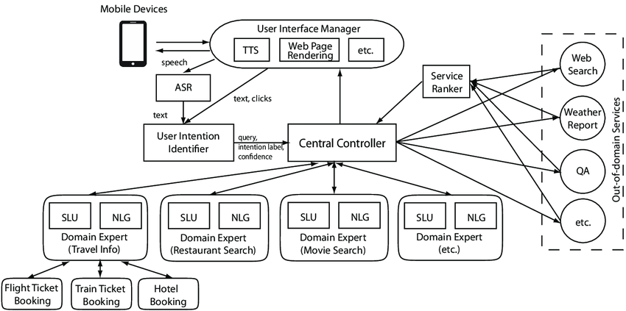
Architecture of a Voice Assistant in general :

Slide 17
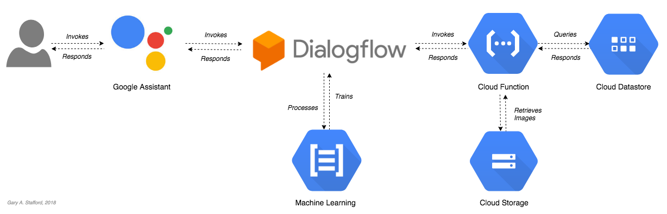
Architecture of an assistant:

Slide 18
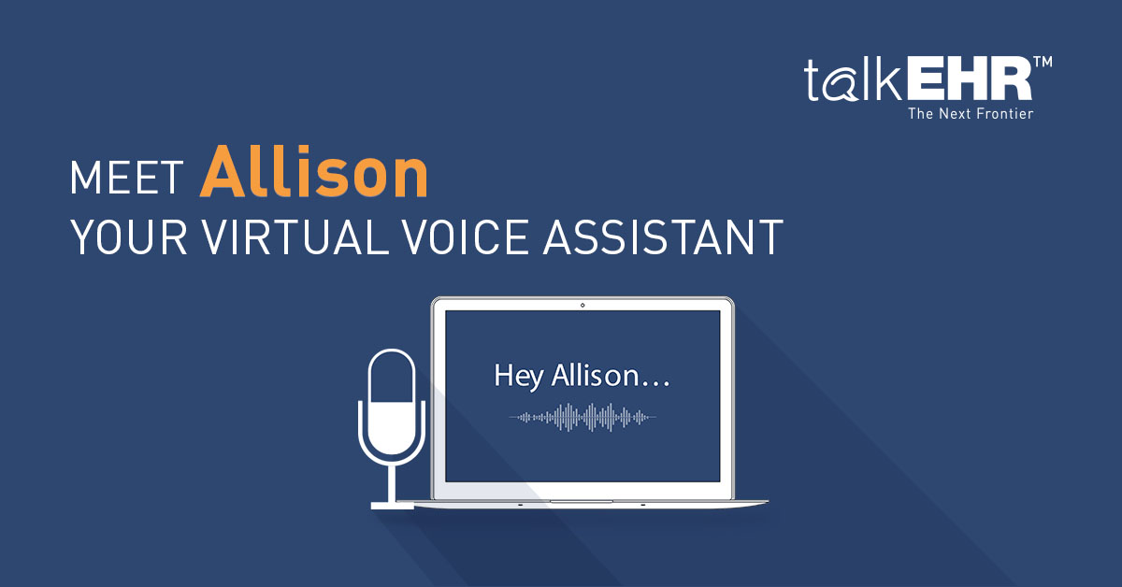

Slide 19
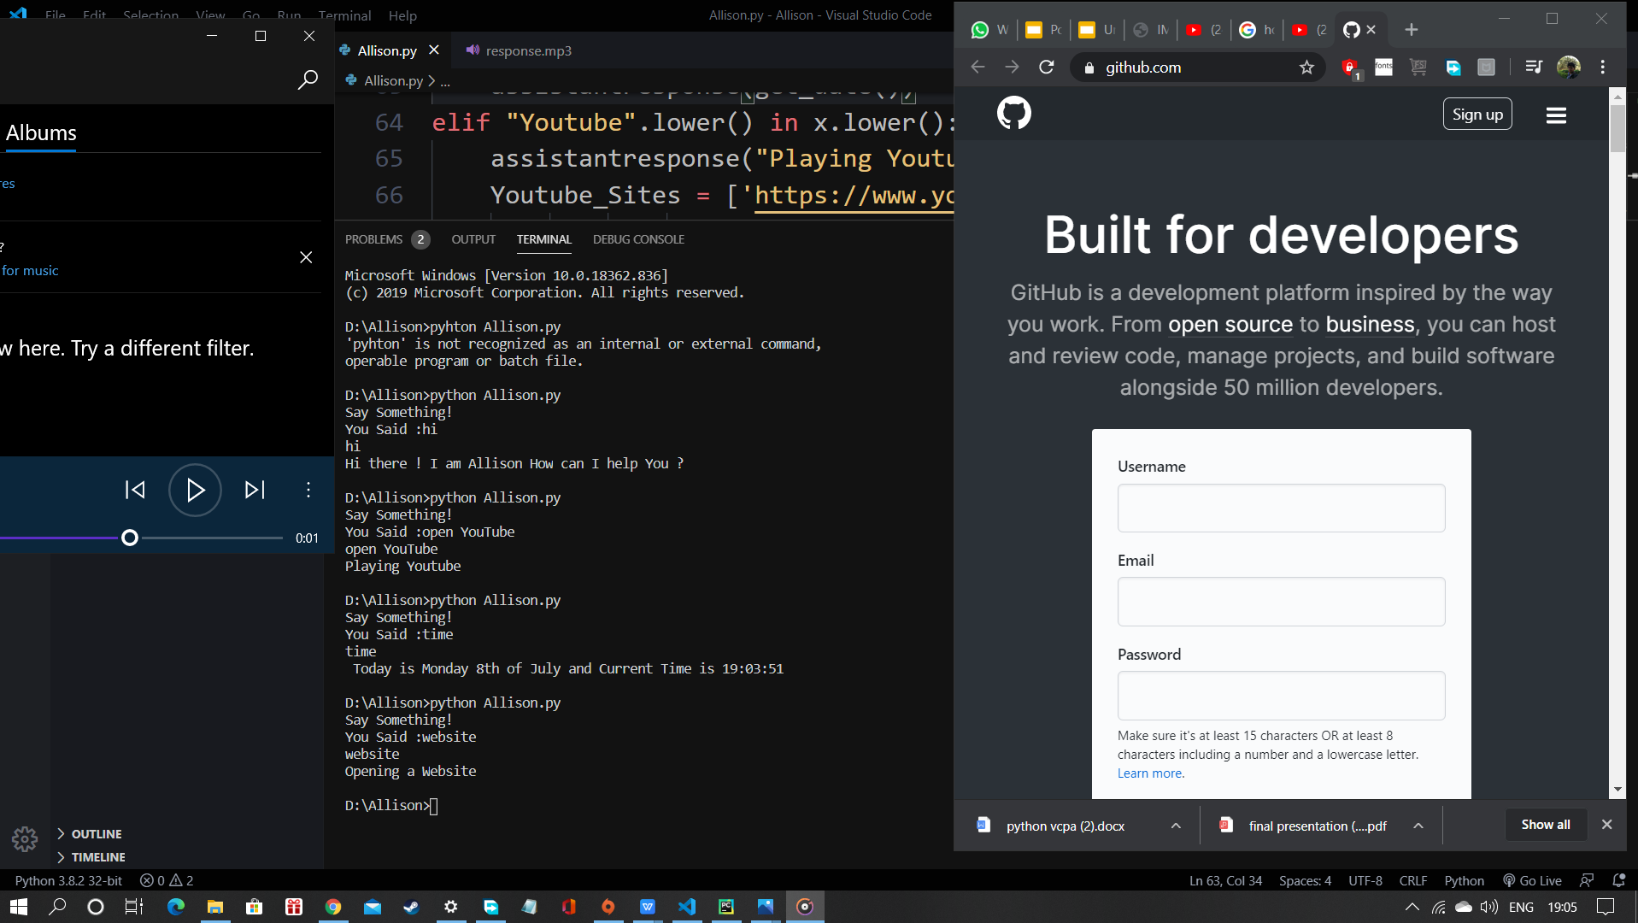
Results : 1.Opening a Website

Slide 20
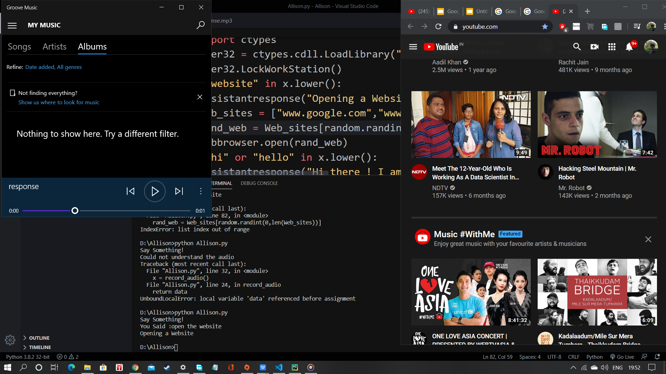
Another Example

Slide 21
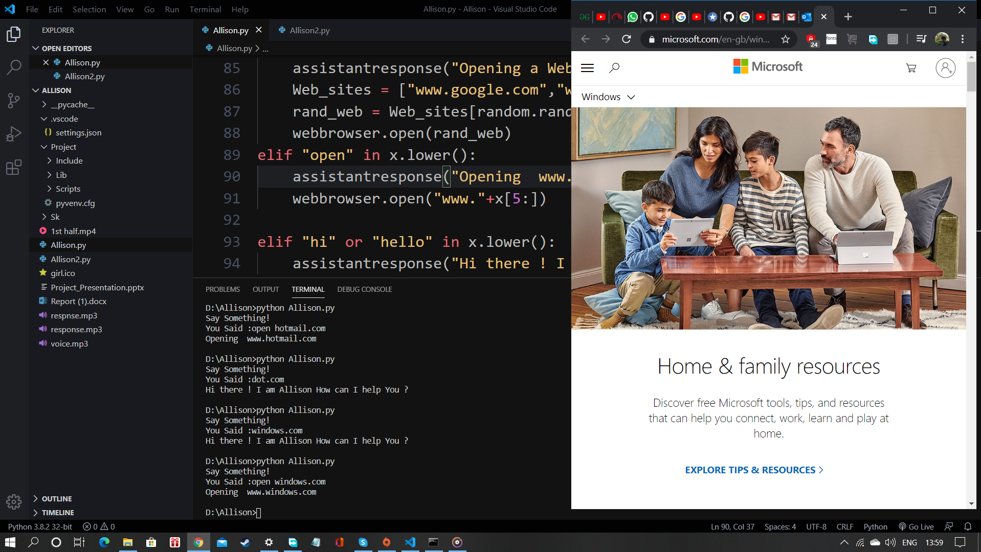
**Example of opening a specific website

Slide 22
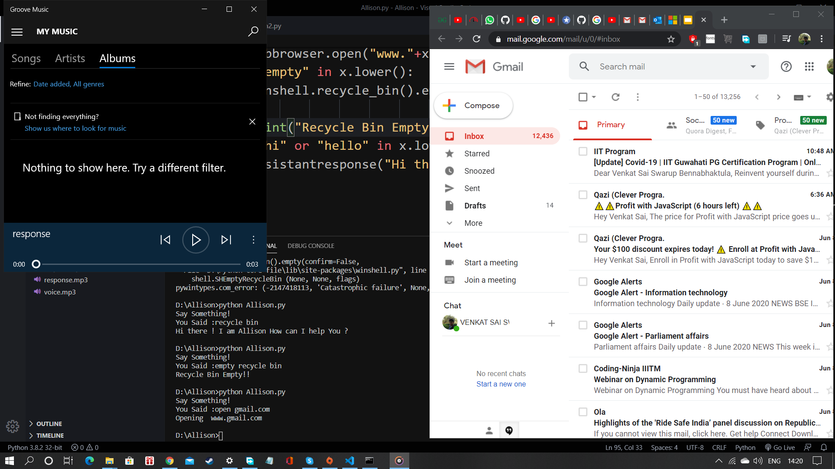
Example of opening gmail.com

Slide 23
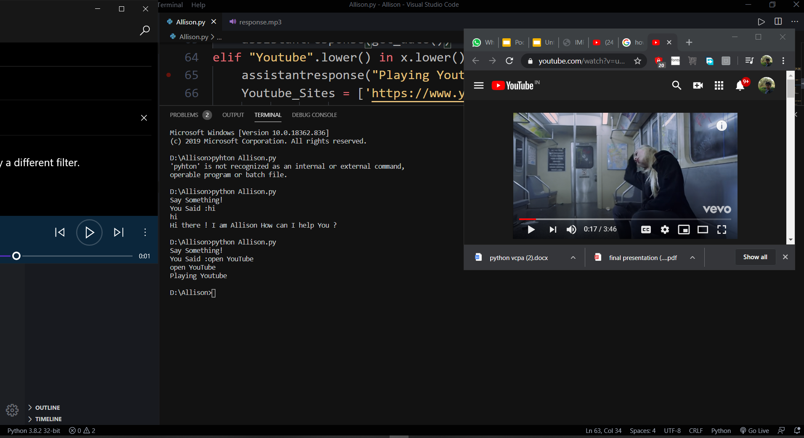
2.Playing Youtube:

Slide 24
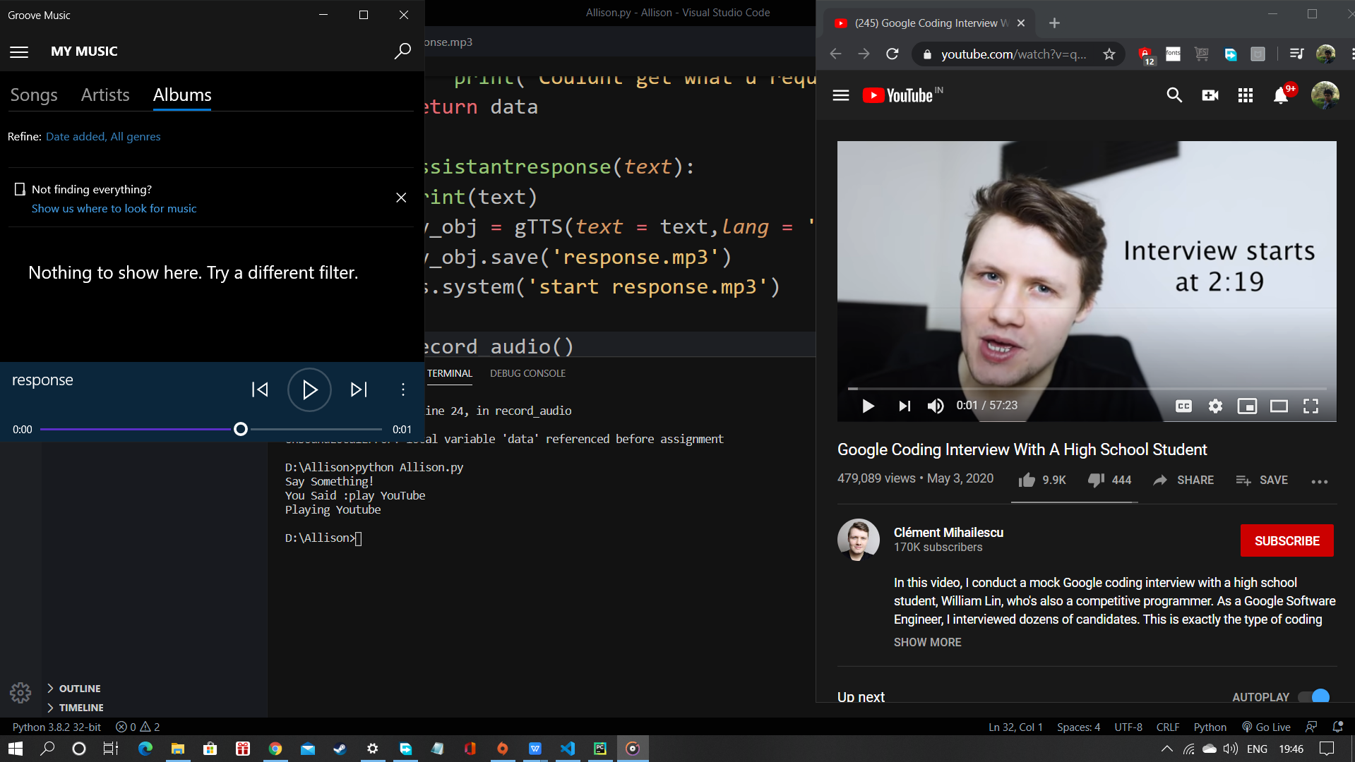
Another example

Slide 25
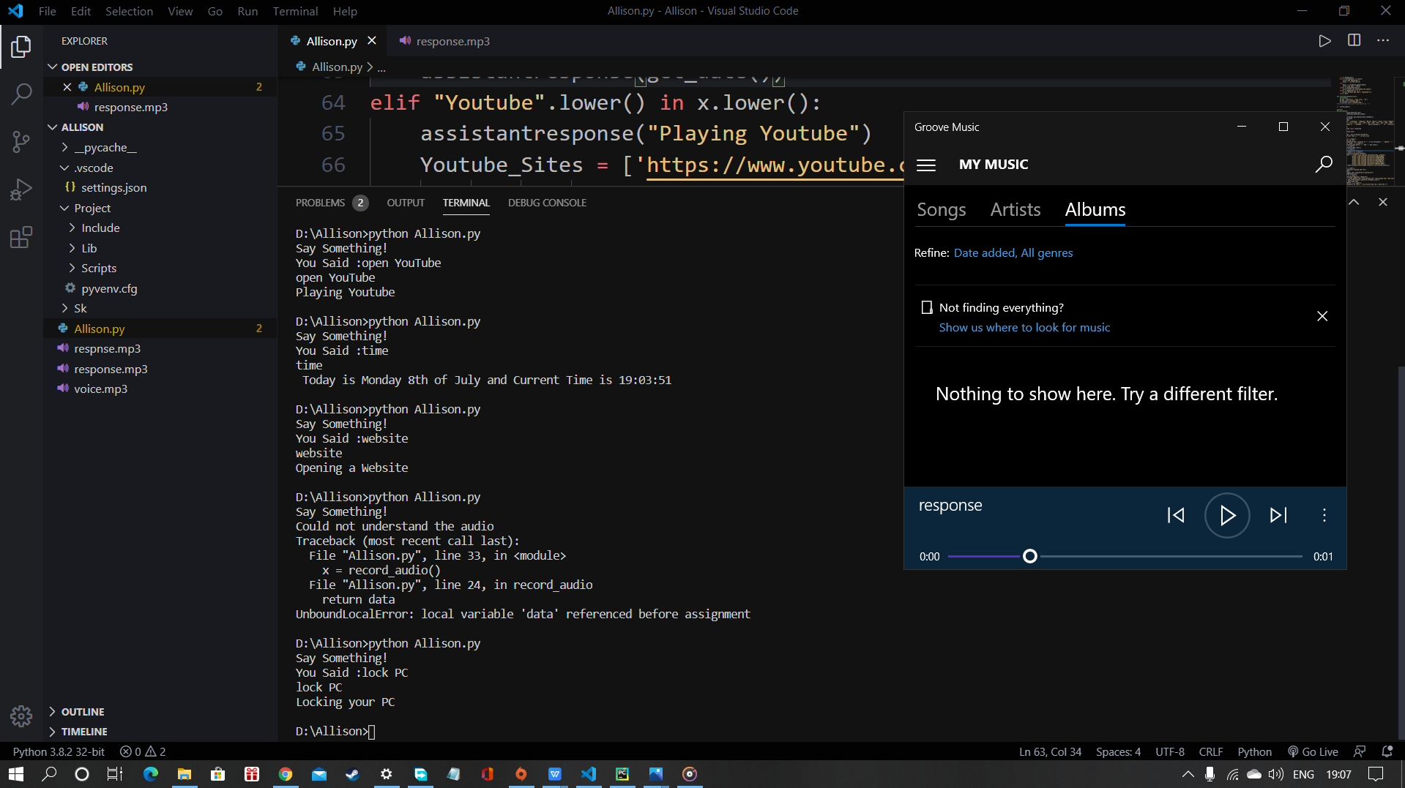
3.Locking your PC:
It was not possible to show locking of PC during screenshot

Slide 26
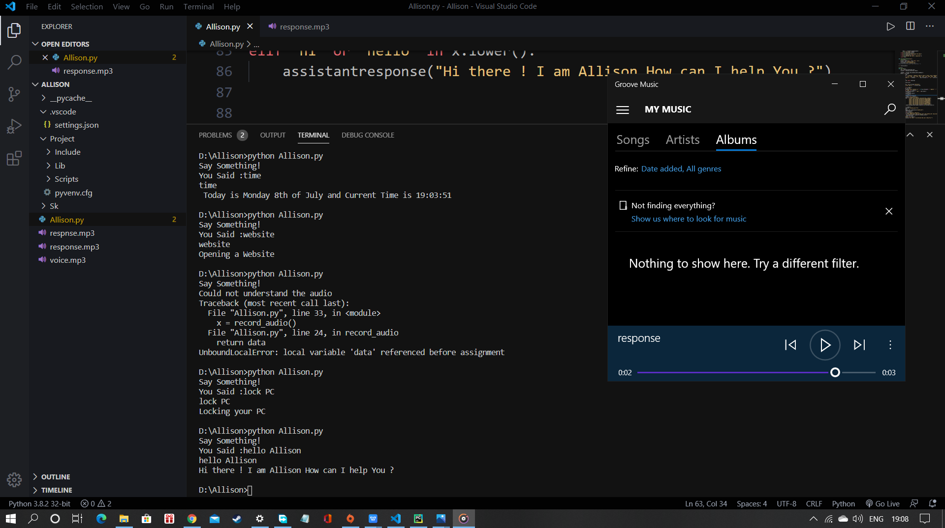
4.Voice to text Conversion:

Slide 27
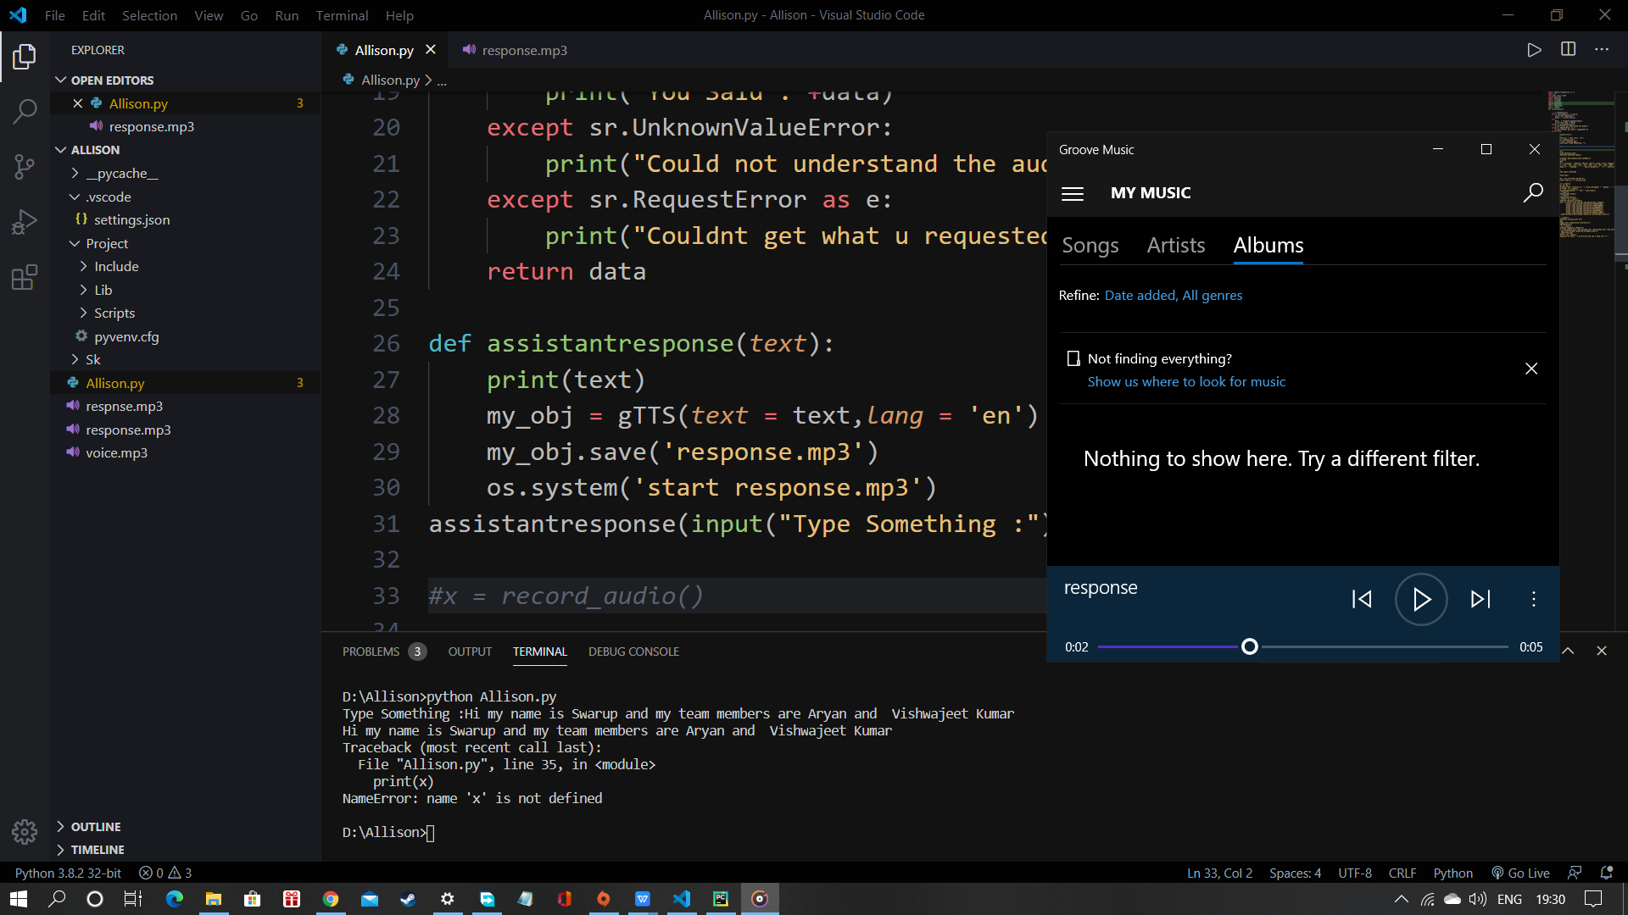
5.Text to Voice conversion :

Slide 28
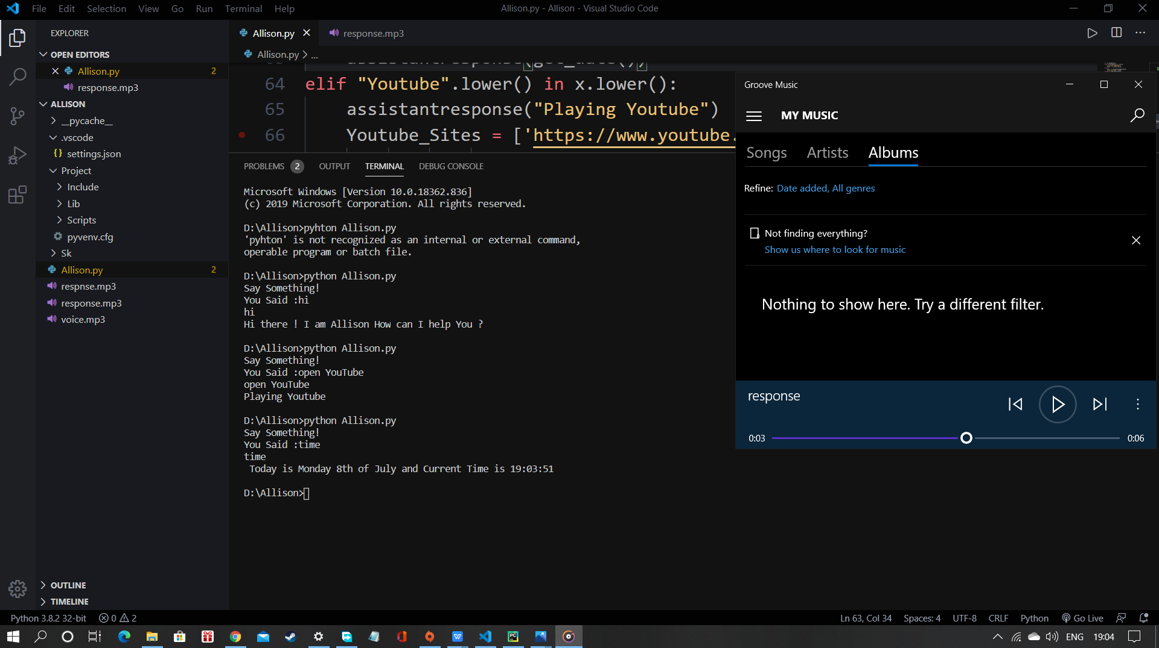
6.Showing Date and Time :

Slide 29
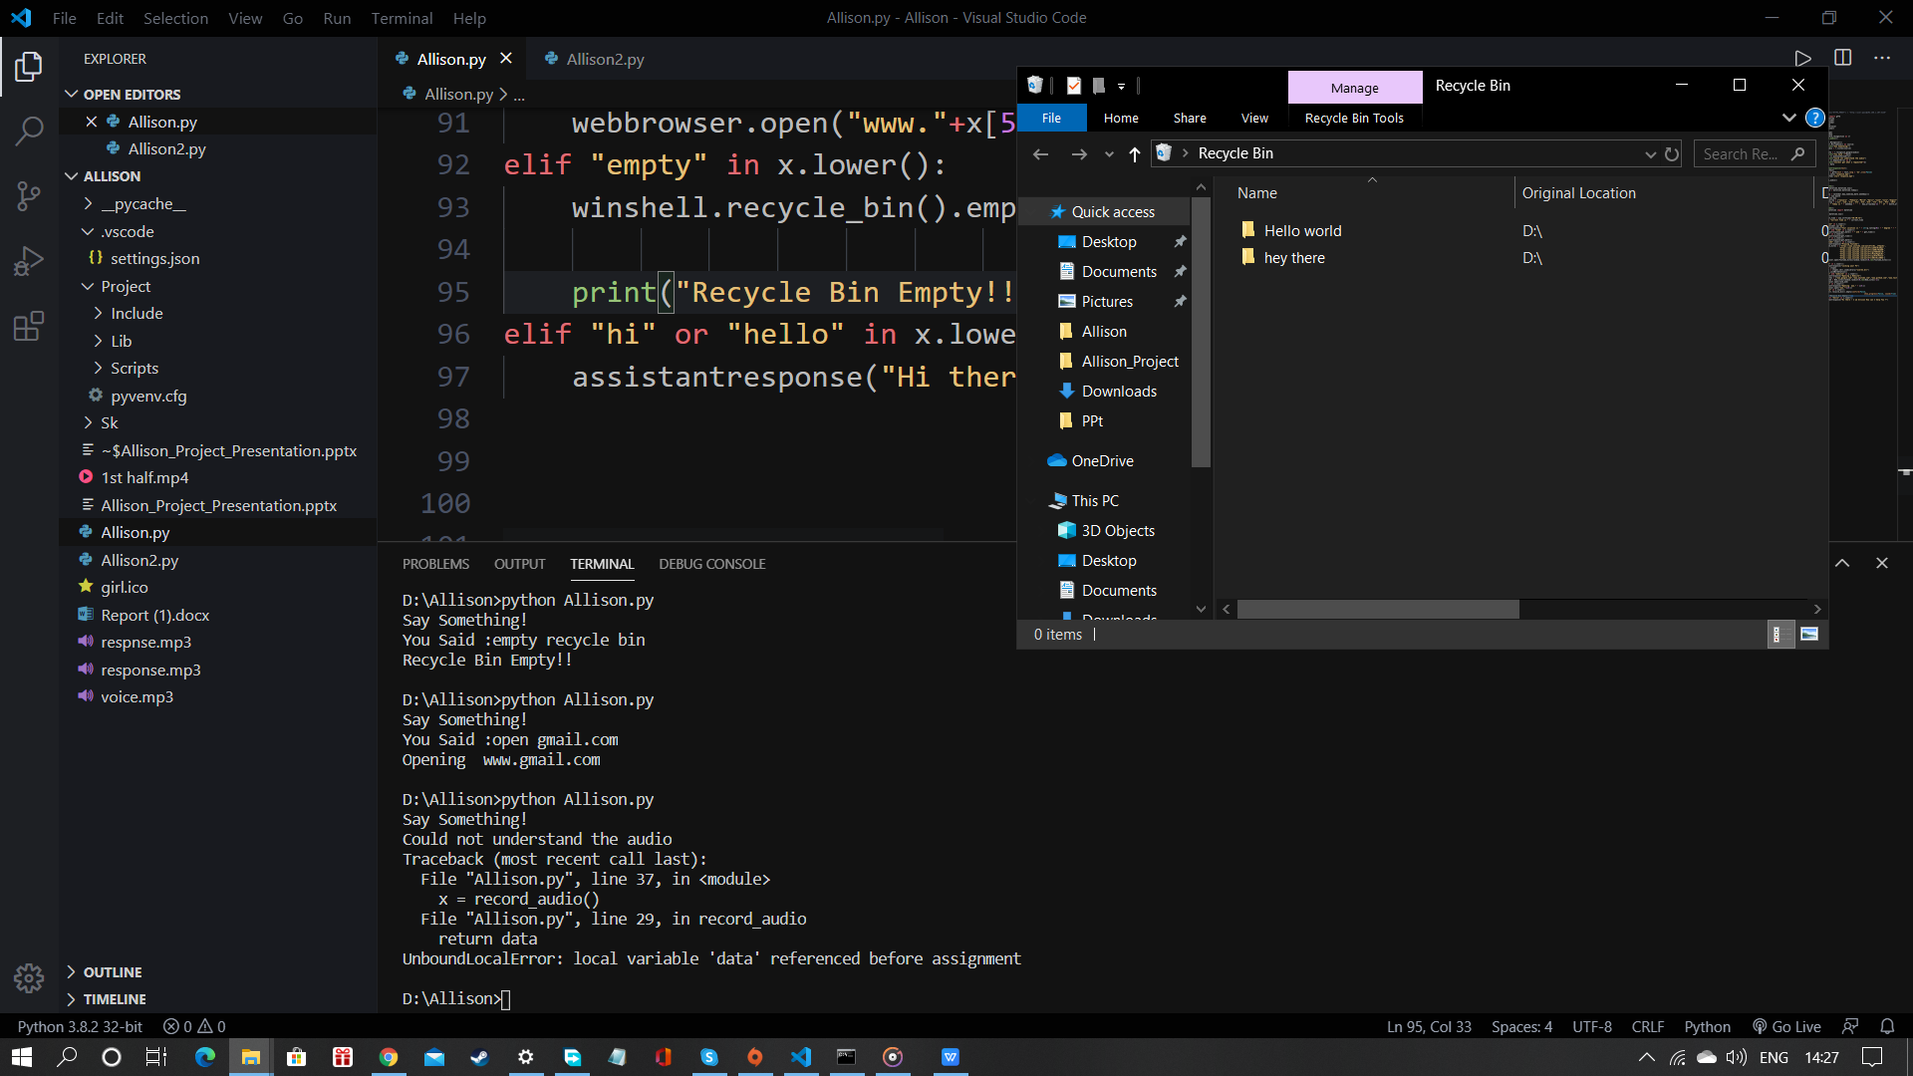
7.Deleting files from Recycle Bin
Initial Recycle Bin :

Slide 30
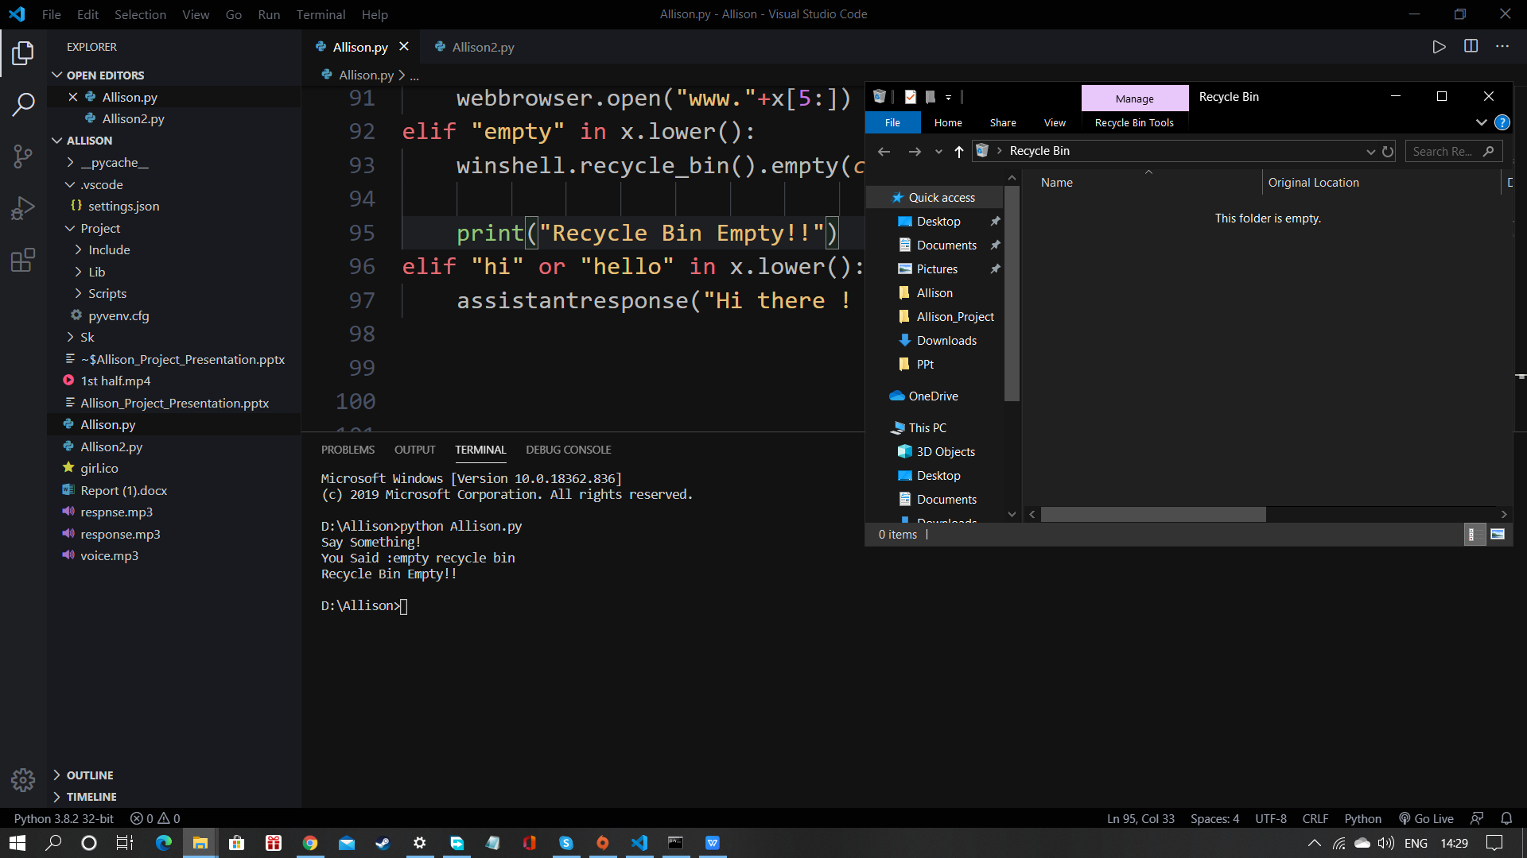
Emptied Recycle Bin :

Slide 31
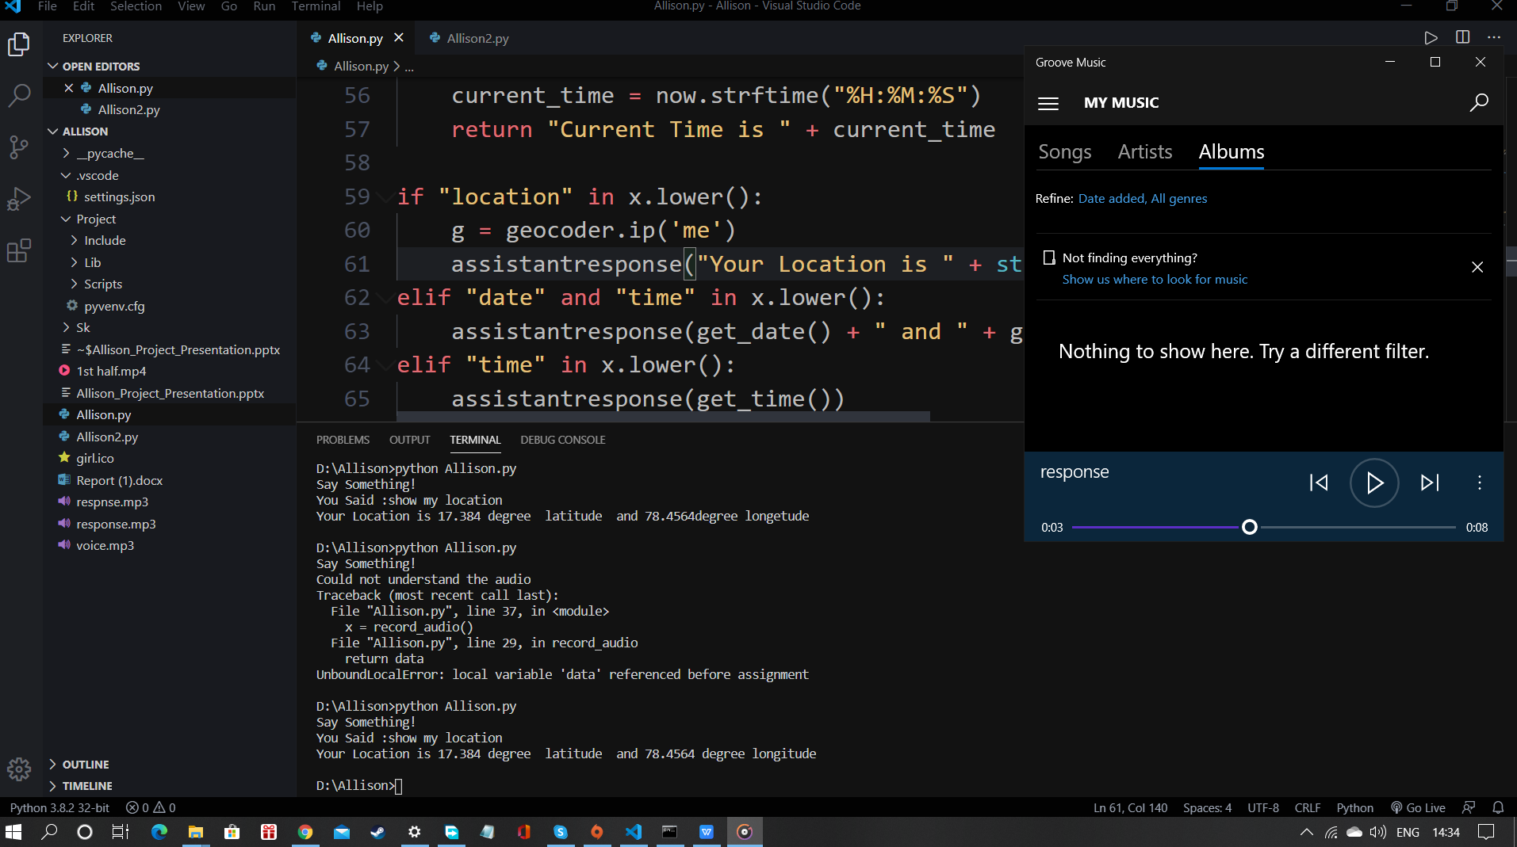
8. Showing Location

Slide 32
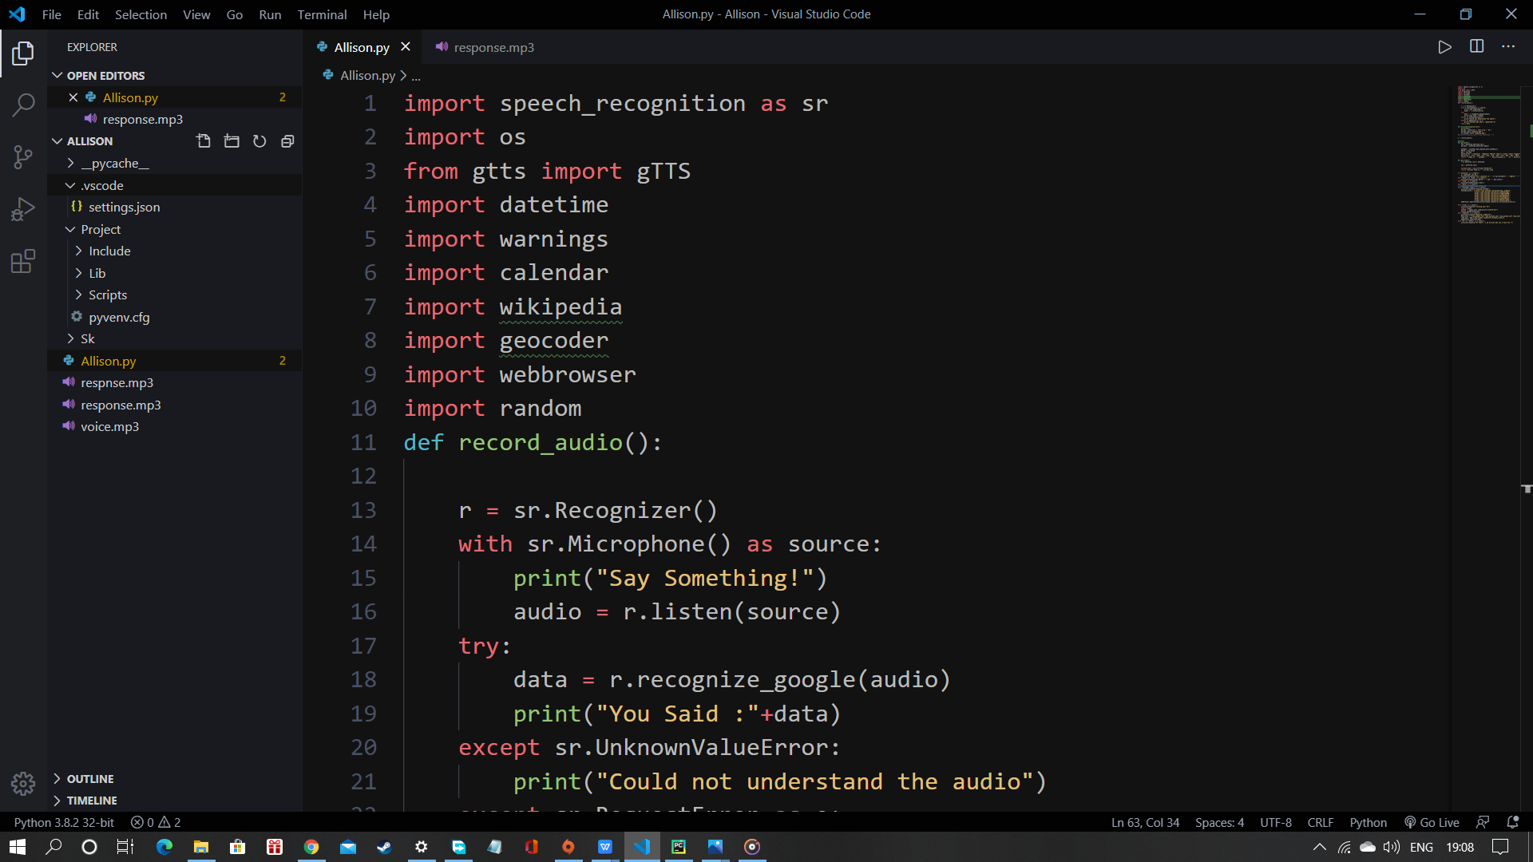
Snippets of Code Section

Slide 33
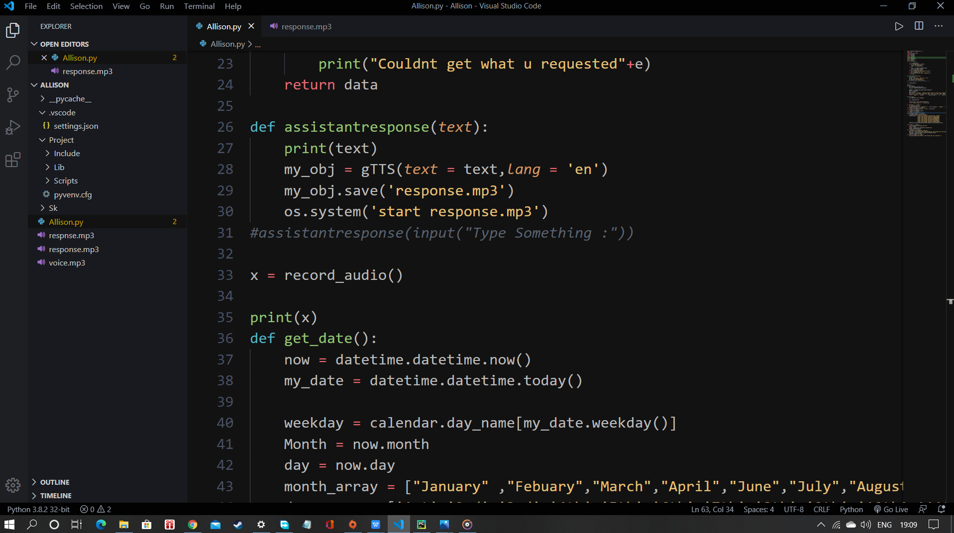

Slide 34
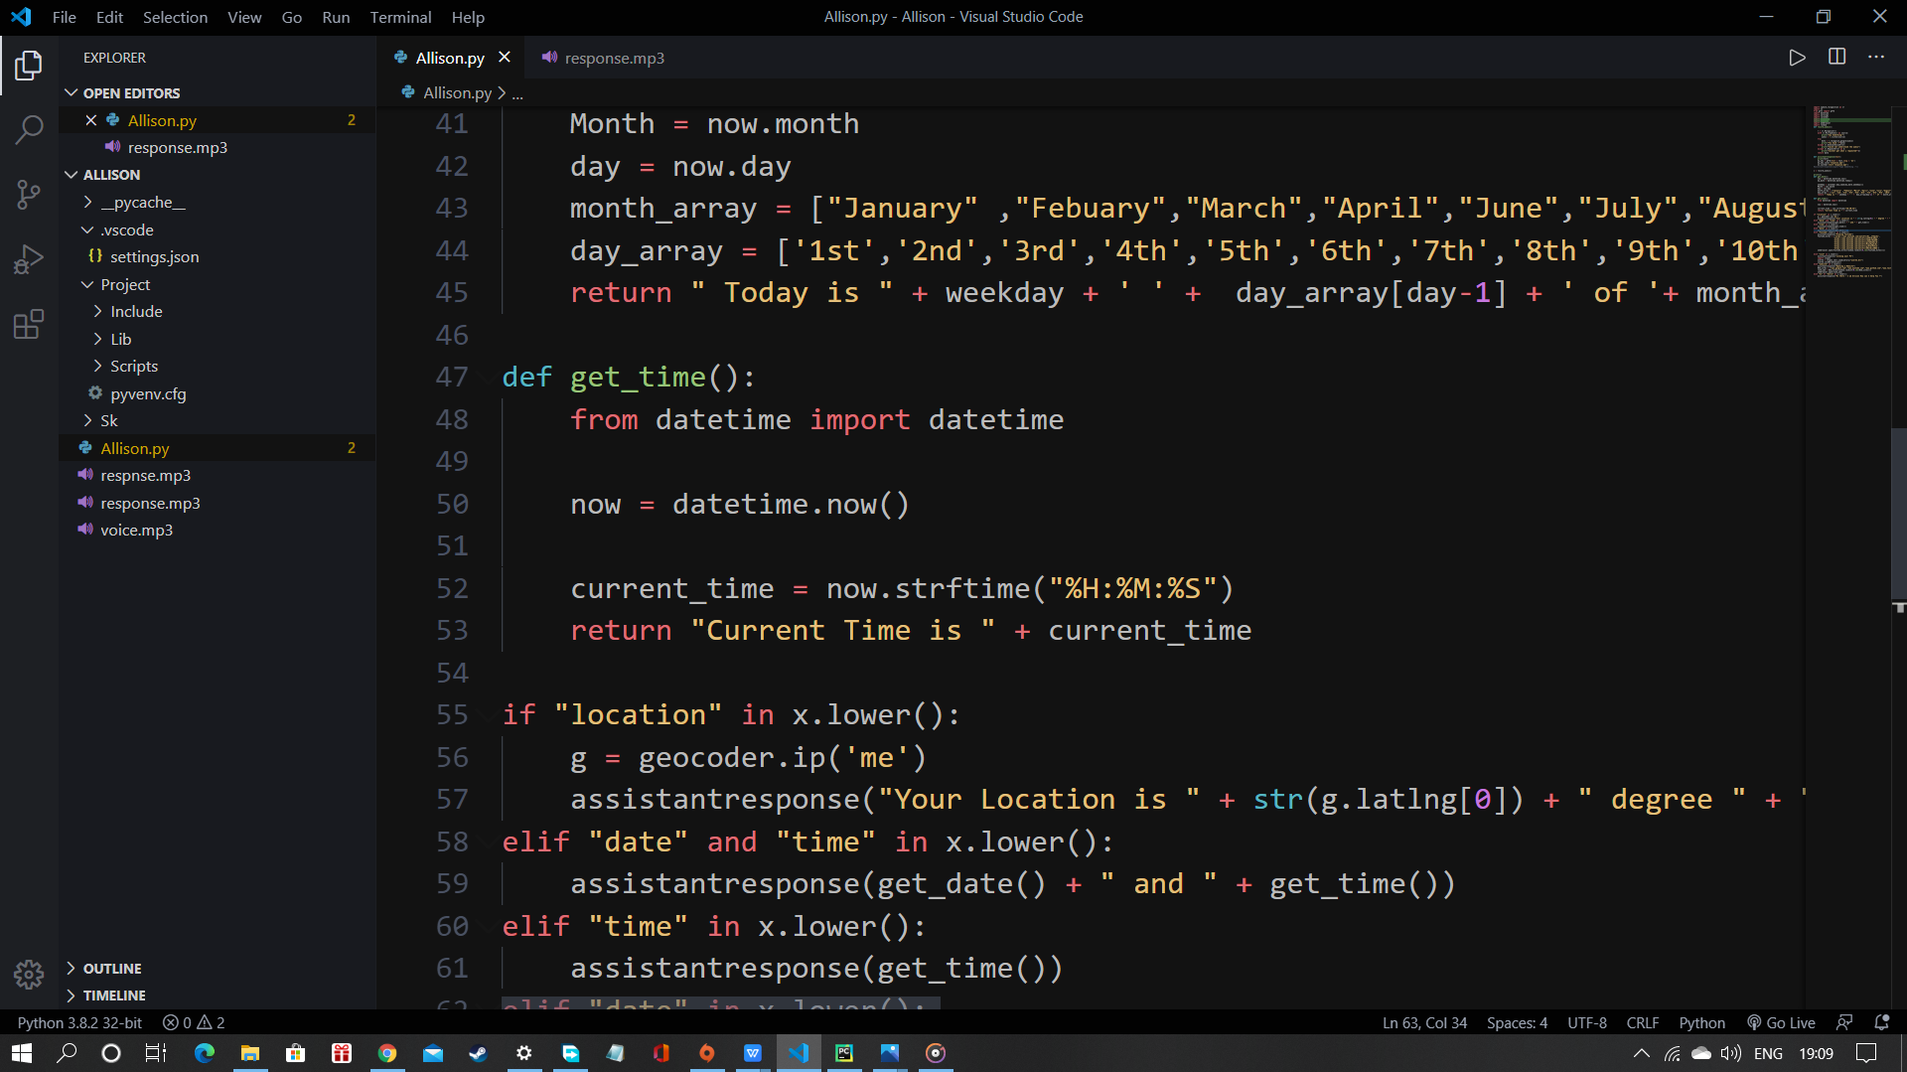

Slide 35
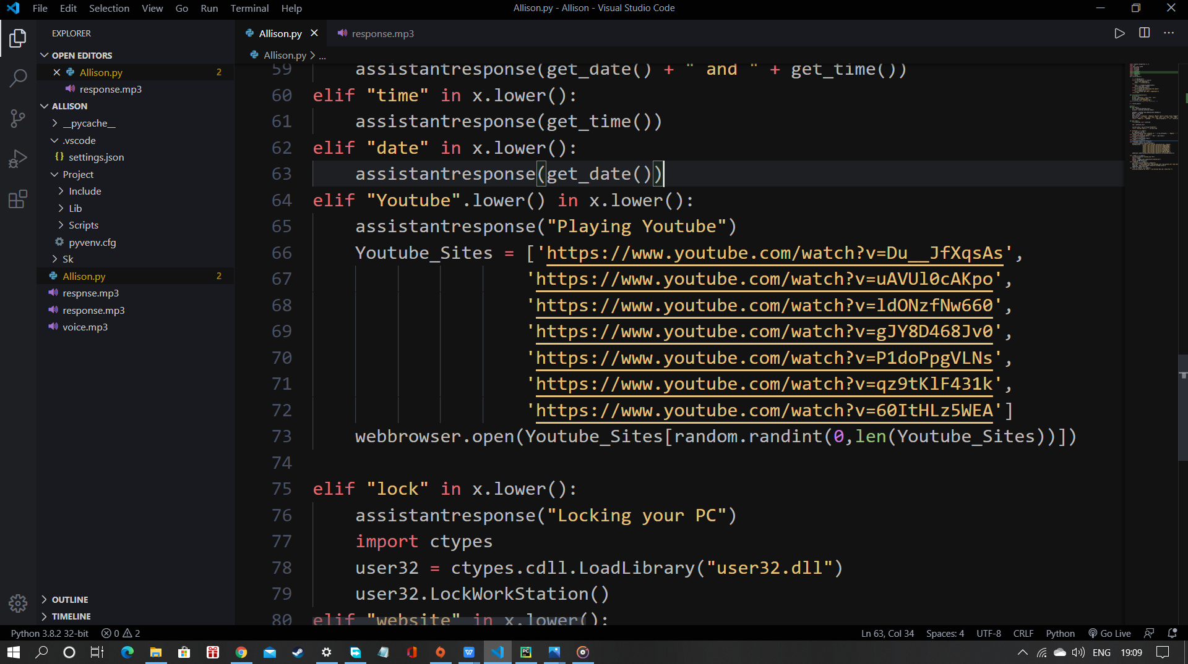

Slide 36
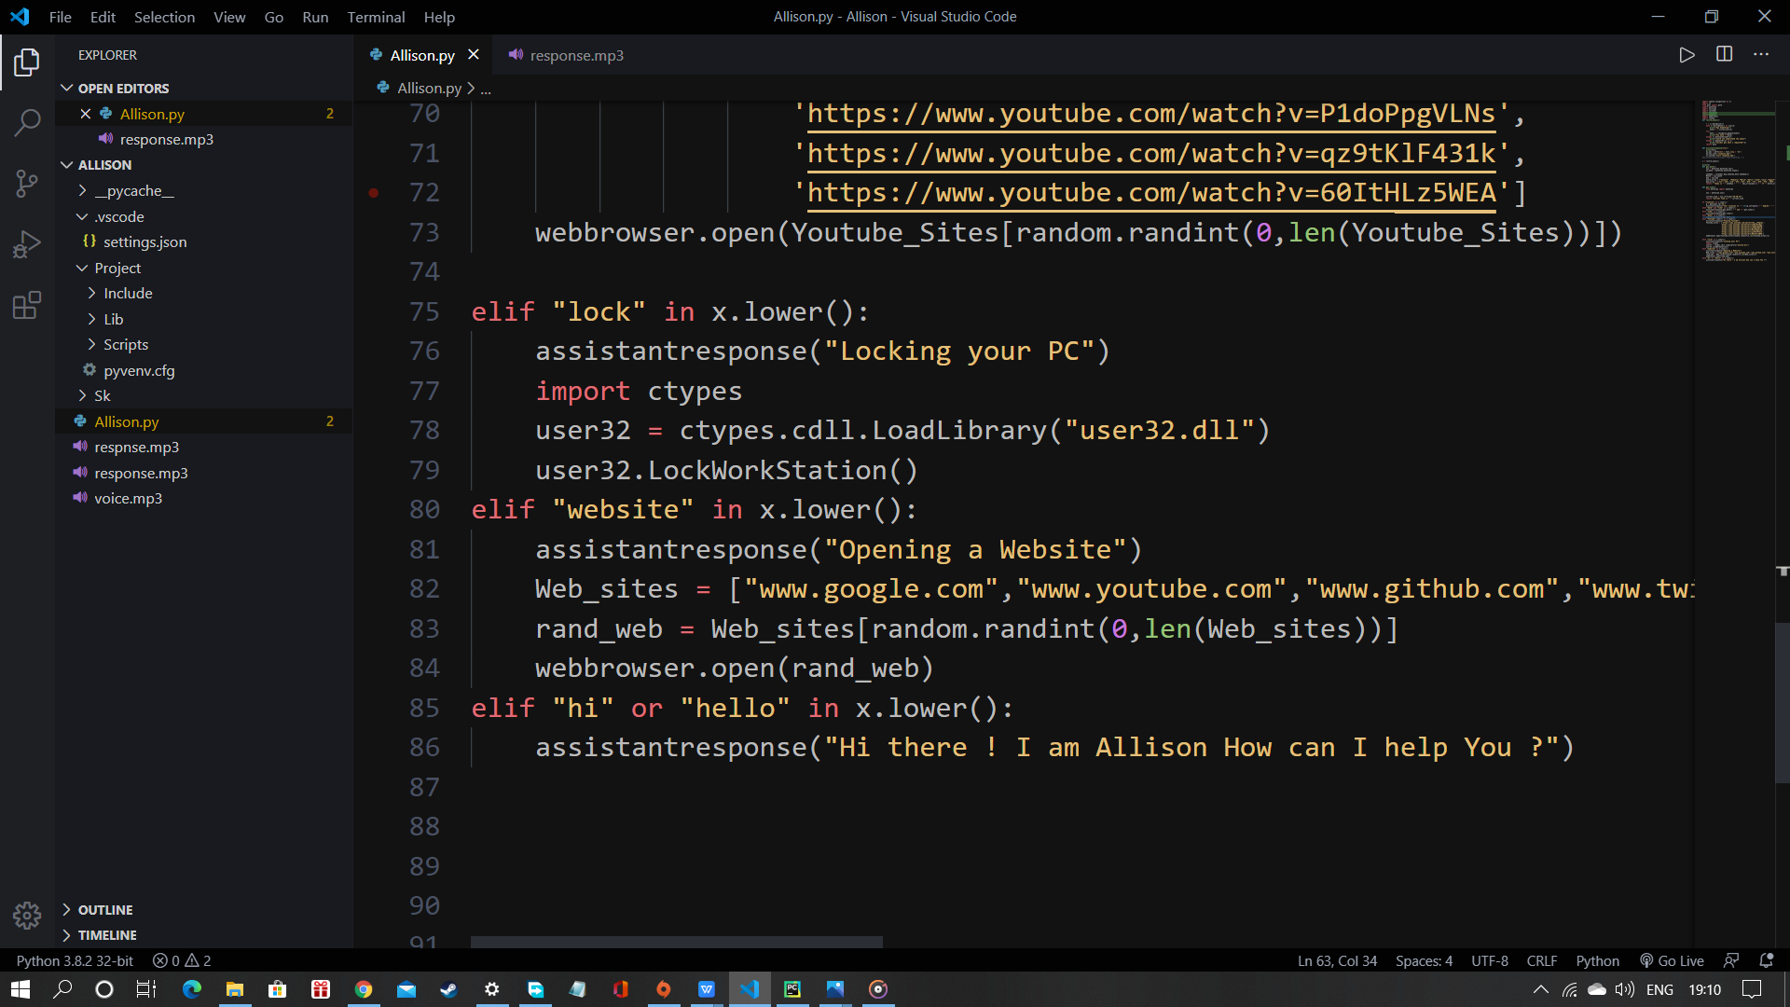

Slide 37
Thank You

